Slide 1
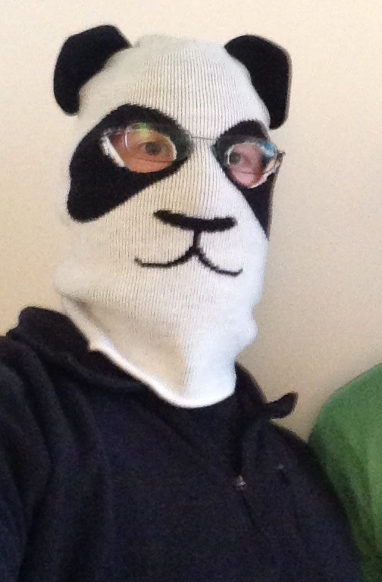



Advancing
FOCUS
FOCUS
Glen R. Goodwin
@areinet
arei.net
github.com/arei
Notes:
Thank you Pariss/Katie.
Greetings everyone.
Before I start
I just want to say
As I look
out at everyone here
That I,
Like all speakers
Who get up on this stage,
am nervous as hell.

Slide 2
Advancing
FOCUS
FOCUS
Glen R. Goodwin
@areinet
arei.net
github.com/arei
Notes:
So thank you in advance
For bearing with me
For laughing at
My lame jokes
And for joining me
On this ride.

Slide 3
Advancing
FOCUS
FOCUS
Glen R. Goodwin
@areinet
arei.net
github.com/arei
Notes:
Now,
That said,
Let’s get this ball rolling.
My name is Glen
and I am here today
to talk to you about
THE MOST EXCITING PART

Slide 4

Notes:
of working with browsers
<quick pause>
A topic
mind you
that will LITERALLY

Slide 5
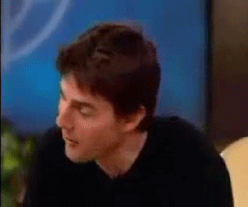
Notes:
make you shout with joy
<quick pause>
and I can tell you are
all SUPER EAGER

Slide 6

Notes:
to hear about
the stupendous

Slide 7
STUPENDOUS
Notes:
amazing

Slide 8
AMAZING
Notes:
and totally riveting...

Slide 9
TOTALLY RIVETING
Notes:
and totally riveting...

Slide 10
Focus Subsystem
Notes:
Focus Subsystem!
<CHEER>
Aww, you can do
Better than that
<CHEER>
<PAUSE>

Slide 11
Focus Subsystem
Notes:
Alright,
I know this isn't
the most glamorous thing
we could be discussing

Slide 12
Focus Subsystem
Notes:
but sometimes
we have to get a little bit
down in the weeds
and take a long hard look
at the tools
we are given
as web developers
and ask
could it be better.
And that's what I want to do today
with the Focus Subsystem

Slide 13
Focus Subsystem
Notes:
and specifically
how we interact with
the focus subsystem
programmatically
via javascript.

Slide 14
Focus Subsystem
Notes:
So we are going to dive
into focus…
what it is,
how it works,
and ask
is it doing
enough for us.
Does it work well?

Slide 15
Does it work well?
Notes:
Does it meet
the needs of the developers?

Slide 16
Does it work well?
Does it meet the needs of the developers?
Notes:
Could it do more
to be better?

Slide 17
Does it work well?
Does it meet the needs of the developers?
Could it do more to be better?
Notes:
<pause>
<water>
So,
In order to answer
These questions

Slide 18
Focus
Notes:
we need to know
exactly what
we are talking about.
So
To be very clear,
When I speak about Focus,
I am not talking
About this…

Slide 19
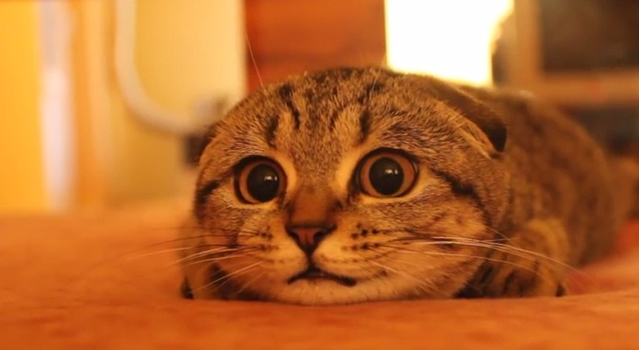
Notes:
As cute as this
Little guy is,
We are not
Talking about focus
In terms of attention.
We are not talking about
Blink and marquee elements.
Instead,
We are talking about
This…

Slide 20
First Name
Last Name
Mailing Address
City
State/Province
Postal Code
Country
Notes:
Fields
And Elements
And where
Input is directed.
When we press a key
On our keyboard
Focus is the system
That directs that keystroke
to our form
And specifically
To our field.
So when I press the
G key

Slide 21
First Name
Last Name
G
Mailing Address
City
State/Province
Postal Code
Country
Notes:
The Focus System
Ensures that the G
Appears in the correct place.
<pause>
Specifically,
Focus,
as it relates to user interfaces,

Slide 22
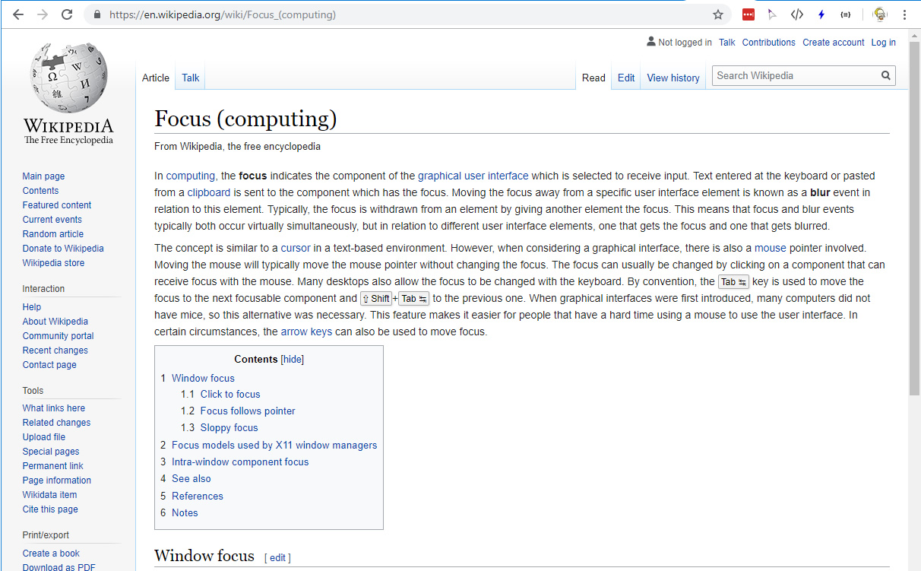
Notes:
is the process
by which the computer
decides what part of the user interface
receives any human interaction.
Be it
A mouse click,
A key stroke,
Or other types
Of user input.
For any given input
The computer must decide
Where in all of its interfaces
That input is being
Directed to.

Slide 23
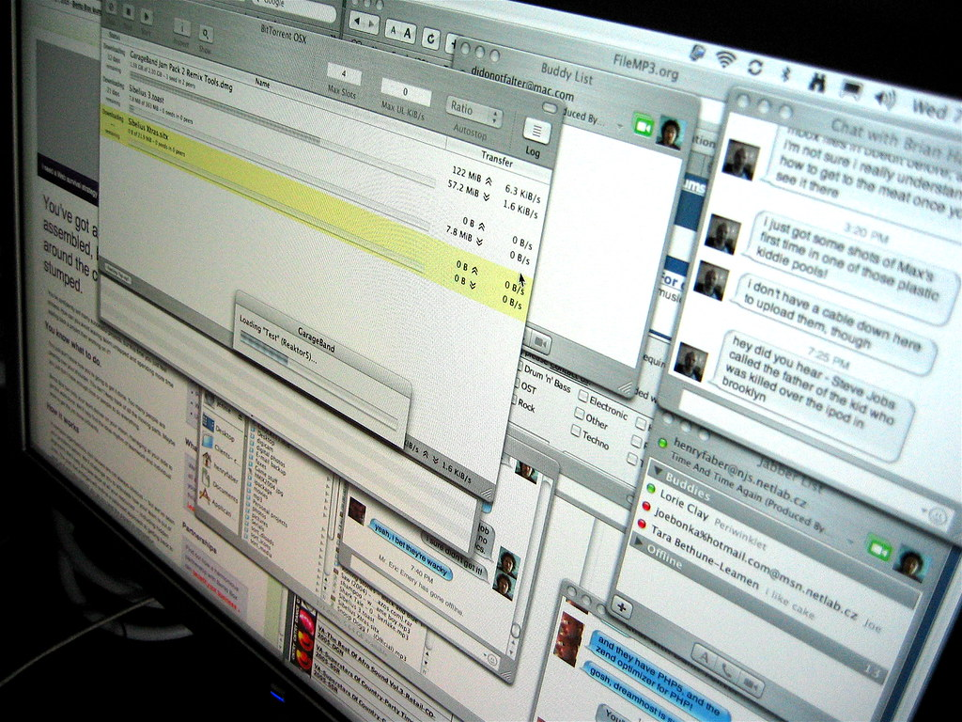
Notes:
And once it determines
Where the input
Is being targeted at
It needs to send it there.
I call this the
Focus flow
And it works
Like this…
We press a key

Slide 24
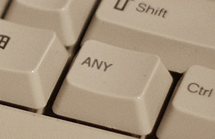
Notes:
The keyboard reports to
the operating system
A keystroke occurred.
The operating system
determines what key was pressed.
Next

Slide 25

Notes:
The operating system
then determines where the user
is currently targeting
their input at...
more precisely,
which window,
is the focus.
<brief pause>
If the browser
is the current window focused,
it tells the browser
about the keyboard press.

Slide 26
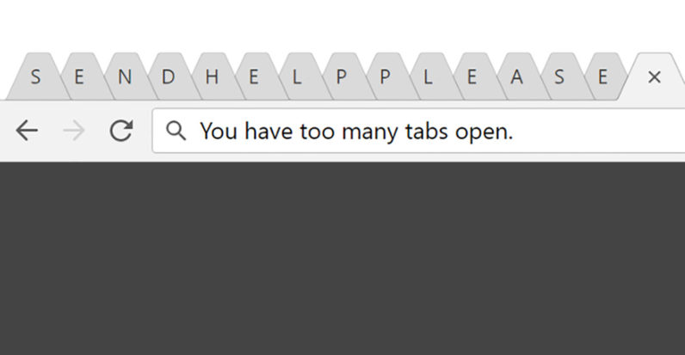
Notes:
The browser then does
exactly what the Operating system did
but within itself
and it determines which window or tab,
within the browser,
is currently targeted
to receive input.
Once the browser has determined
which window or tab
has the focus,

Slide 27
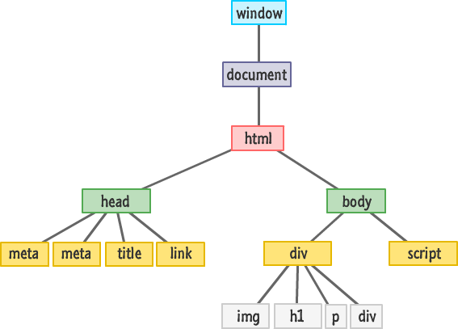
Notes:
it finds the associated
top-level DOM document
for that window or tab.
The DOM Document
tracks which specific element
in the DOM
is currently targeted
to receive input.
It does this
In a property
called "activeElement".

Slide 28
document.activeElement
Notes:
Whenever focus is changed
In a document,
activeElement is updated.
So the browser
Looks at activeElement
And it knows to
Deliver our keystroke
To that element.
This is
the Focus flow…

Slide 29
Keyboard
Operating System
Application (Browser)
Tab/Window
Document
Element
Notes:
The series of focus decisions
at every level.
From the operating system level
to the application level
to the DOM level.
<pause>

Slide 30
Properties
document.activeElement
Methods
element.focus()
element.blur()
Events
focus
blur
focusin
focusout
Notes:
The activeElement,
Along with the two methods
focus() and blur()
And the four events
focus,
blur,
focusin,
focusout
make up the focus subsystem
As we know it.

Slide 31
Properties
document.activeElement
Methods
element.focus()
element.blur()
Events
focus
blur
focusin
focusout
Notes:
These 7 pieces
This is everything the browser
programmatically gives us
to understand focus
and manipulate it.
That's it.
In its entirety.
And that's what
we are talking about today.
The focus subsystem;
<pause>
<water>

Slide 32
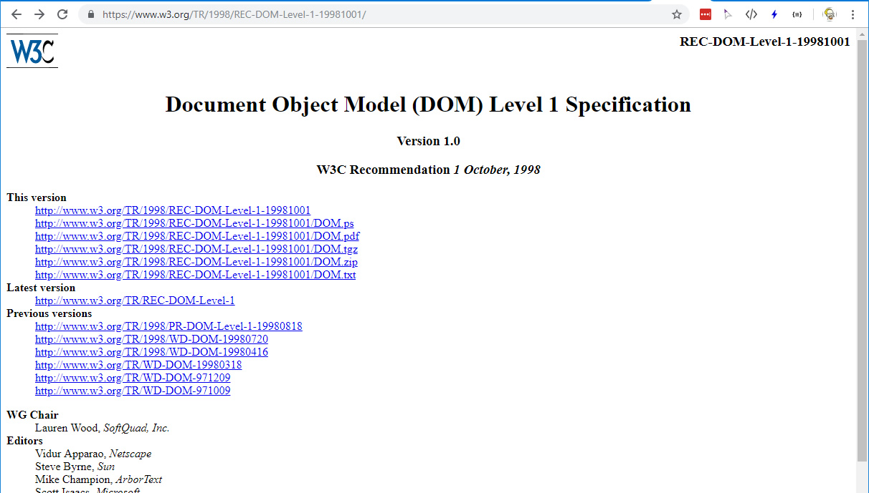
Notes:
The focus subsystem
was first formally added
to the Document Object Model Specification Level 1
in January of 1998,
with a few minor tweaks
a few years later.

Slide 33
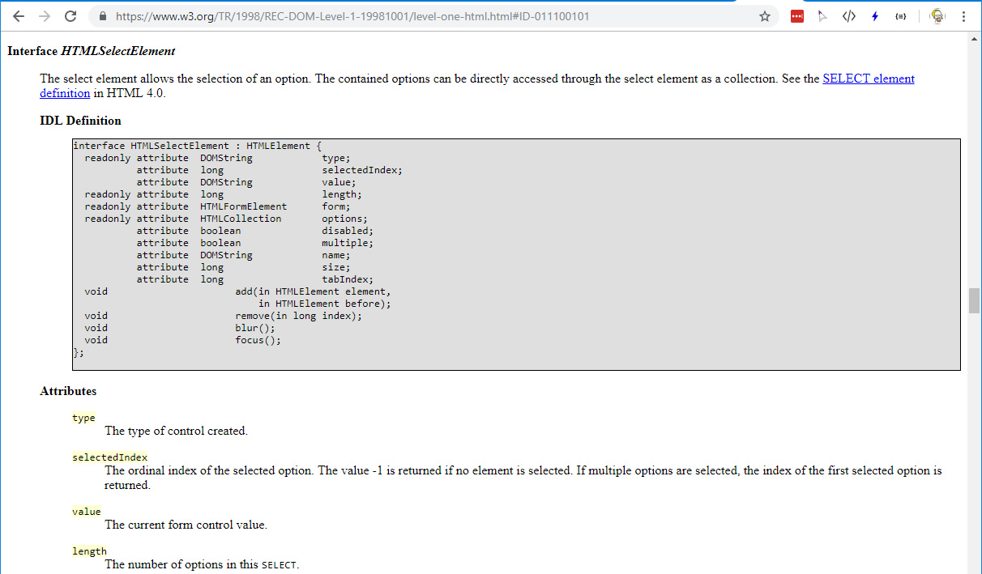
Notes:
And unsurprisingly,
the focus subsystem hasn't
changed significantly
since then.
And that's fine.
It's a 20 year old API
and it does its job.
Or does it?
<pause>
So, Say you are
an incredibly dashing

Slide 34
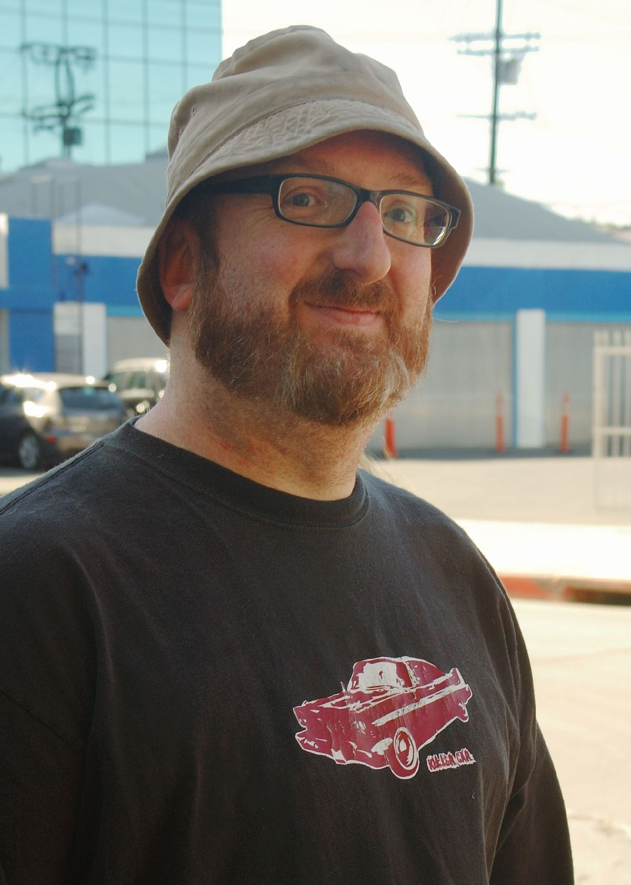
Not really Glen…
But pretend it is and he's as dashing as
international
heart-throb
Brian Posehn…
Notes:
web developer
named glen.
And you need to write a web component
that wraps a single field
for entering a username.
Like this…

Slide 35
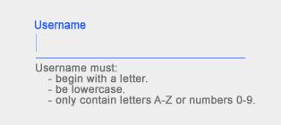
Notes:
And your customer
comes to you
and says
they want the ENTER KEY
to advance the focus
to the next field.

Slide 36

Notes:
So our code might look like this:

Slide 37
import {ZephComponents,html,onEventAt} from "ZephJS";
ZephComponents.define("my-user-field",()=>{
html(`
<div class="wrapper">
<input class="field" type="text"></input>
</div>
`);
onEventAt("input","keyup",(element,content,event)=>{
if (event.keyCode===13) {
???????????????
}
});
});
Notes:
A note here...
I'm using a library
Called ZephJS to define
the web component.
ZephJS is a
tiny and powerful way
to write web components
super easily.

Slide 38

zephjs.com
Notes:
You can check it out at
zephjs.com
Anyway
back to our story.

Slide 39
zephjs.com
Notes:
We have a customer
that wants a web component
for entering a username
they can re-use
AND it must advance the focus
when ENTER is pressed.
Here's our code again

Slide 40
import {ZephComponents,html,onEventAt} from "ZephJS";
ZephComponents.define("my-user-field",()=>{
html(`
<div class="wrapper">
<input class="field" type="text"></input>
</div>
`);
onEventAt("input","keyup",(element,content,event)=>{
if (event.keyCode===13) {
???????????????
}
});
});
Notes:
And going through
This code very quickly…

Slide 41
import {ZephComponents,html,onEventAt} from "ZephJS";
ZephComponents.define("my-user-field",()=>{
html(`
<div class="wrapper">
<input class="field" type="text"></input>
</div>
`);
onEventAt("input","keyup",(element,content,event)=>{
if (event.keyCode===13) {
???????????????
}
});
});
Notes:
To begin
we import what we need
from ZephJS.

Slide 42
import {ZephComponents,html,onEventAt} from "ZephJS";
ZephComponents.define("my-user-field",()=>{
html(`
<div class="wrapper">
<input class="field" type="text"></input>
</div>
`);
onEventAt("input","keyup",(element,content,event)=>{
if (event.keyCode===13) {
???????????????
}
});
});
Notes:
Then,
we define our "my-user-field" component.
With ZephJS
You provide the name
Of the component you are defining
And a function
That describes the details
Of the new component

Slide 43
import {ZephComponents,html,onEventAt} from "ZephJS";
ZephComponents.define("my-user-field",()=>{
html(`
<div class="wrapper">
<input class="field" type="text"></input>
</div>
`);
onEventAt("input","keyup",(element,content,event)=>{
if (event.keyCode===13) {
???????????????
}
});
});
Notes:
Within this definition function
we define the HTML content
for our component,
And

Slide 44
import {ZephComponents,html,onEventAt} from "ZephJS";
ZephComponents.define("my-user-field",()=>{
html(`
<div class="wrapper">
<input class="field" type="text"></input>
</div>
`);
onEventAt("input","keyup",(element,content,event)=>{
if (event.keyCode===13) {
???????????????
}
});
});
Notes:
We tell our component
how we want to handle
the KEYUP event
on the INPUT element.
This KEYUP event
Is what we are watching
To know when
The ENTER key
Is pressed.

Slide 45
import {ZephComponents,html,onEventAt} from "ZephJS";
ZephComponents.define("my-user-field",()=>{
html(`
<div class="wrapper">
<input class="field" type="text"></input>
</div>
`);
onEventAt("input","keyup",(element,content,event)=>{
if (event.keyCode===13) {
???????????????
}
});
});
Notes:
That's it.
That's our
admittedly simple
web component definition
for our username field.
Once defined
anytime the <my-user-field> element
is used within the html document
this code will be used.
Now, most of you
have noticed
this line right here.

Slide 46
import {ZephComponents,html,onEventAt} from "ZephJS";
ZephComponents.define("my-user-field",()=>{
html(`
<div class="wrapper">
<input class="field" type="text"></input>
</div>
`);
onEventAt("input","keyup",(element,content,event)=>{
if (event.keyCode===13) {
???????????????
}
});
});
Notes:
This is where we want
to put the code
to change the focus
when the ENTER key is pressed.
But there's a problem here.
With our current
Focus subsystem
In order to advance
The focus
From one element
To the next
We use the Element.Focus() method.

Slide 47
Properties
document.activeElement
Methods
element.focus()
element.blur()
Events
focus
blur
focusin
focusout
Notes:
element.focus()
is executed on
The element we want
To give the focus to…
But how does our
Web Component
know what element
It wants to advance
our focus to?

Slide 48
import {ZephComponents,html,onEventAt} from "ZephJS";
ZephComponents.define("my-user-field",()=>{
html(`
<div class="wrapper">
<input class="field" type="text"></input>
</div>
`);
onEventAt("input","keyup",(element,content,event)=>{
if (event.keyCode===13) {
???????????????
}
});
});
Notes:
A Web Component is built
to actively NOT KNOW
about what exists
outside of it.

Slide 49
import {ZephComponents,html,onEventAt} from "ZephJS";
ZephComponents.define("my-user-field",()=>{
html(`
<div class="wrapper">
<input class="field" type="text"></input>
</div>
`);
onEventAt("input","keyup",(element,content,event)=>{
if (event.keyCode===13) {
???????????????
}
});
});
Notes:
Using the current focus subsystem
We have no easy way
to just tell the focus
to advance to the next place.
This is the first problem
I want to call your attention to
with the current focus subsystem.
There exists
No programmatic way
to advance the focus.

Slide 50
import {ZephComponents,html,onEventAt} from "ZephJS";
ZephComponents.define("my-user-field",()=>{
html(`
<div class="wrapper">
<input class="field" type="text"></input>
</div>
`);
onEventAt("input","keyup",(element,content,event)=>{
if (event.keyCode===13) {
???????????????
}
});
});
Notes:
Now,
Some of you are
probably thinking
just walk the tree
starting at the current element
and locate the next element
which can receive focus
and advance to that.
But this brings up
a second problem
with our current focus subsystem…

Slide 51
import {ZephComponents,html,onEventAt} from "ZephJS";
ZephComponents.define("my-user-field",()=>{
html(`
<div class="wrapper">
<input class="field" type="text"></input>
</div>
`);
onEventAt("input","keyup",(element,content,event)=>{
if (event.keyCode===13) {
???????????????
}
});
});
Notes:
What makes an element
able to receive focus?
What indicates something is focusable?
And there are some
easy answers here…

Slide 52
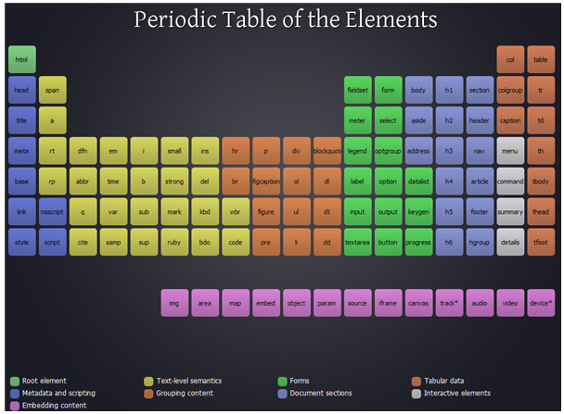
Notes:
If the element is an INPUT tag

Slide 53
Notes:
or SELECT tag

Slide 54
Notes:
or LINK or ANCHOR

Slide 55
Notes:
or BUTTON tag

Slide 56
Notes:
or TEXTAREA tag

Slide 57
Notes:
or the first SUMMARY child
Of a DETAILS element

Slide 58
Notes:
or CONTENT EDITABLE

Slide 59
Notes:
<PAUSE>
EXCEPT

Slide 60
EXCEPT!
Notes:
If it is DISABLED
<fast>

Slide 61
?
Notes:
or TABINDEX is equal to
negative one
or it is HIDDEN
or within a
disabled FIELDSET
or FORM
or otherwise not VISIBLE
or not INERT
or…
Or…
Or…

Slide 62
?
Notes:
See, determining what is Focusable
is really hard.
and even more problematic
is that it is
incredibly inconsistent
across different browsers.
Chrome might handle
Disabled SELECT elements
Different than Firefox does.

Slide 63
?
Notes:
And that doesn’t
Even begin to take
Into account
The ARIA attributes
Which are,
Comparatively,
New players
In the focus space
And not at all
Accounted for
20 years ago.
ARIA has
HUGE implications
On focus
And focus traversal.

Slide 64
?
Notes:
Understanding what allows focus
and what doesn’t
is tricky
and full of
literally thousands
of edge cases.
Someone even made
A fancy chart

Slide 65
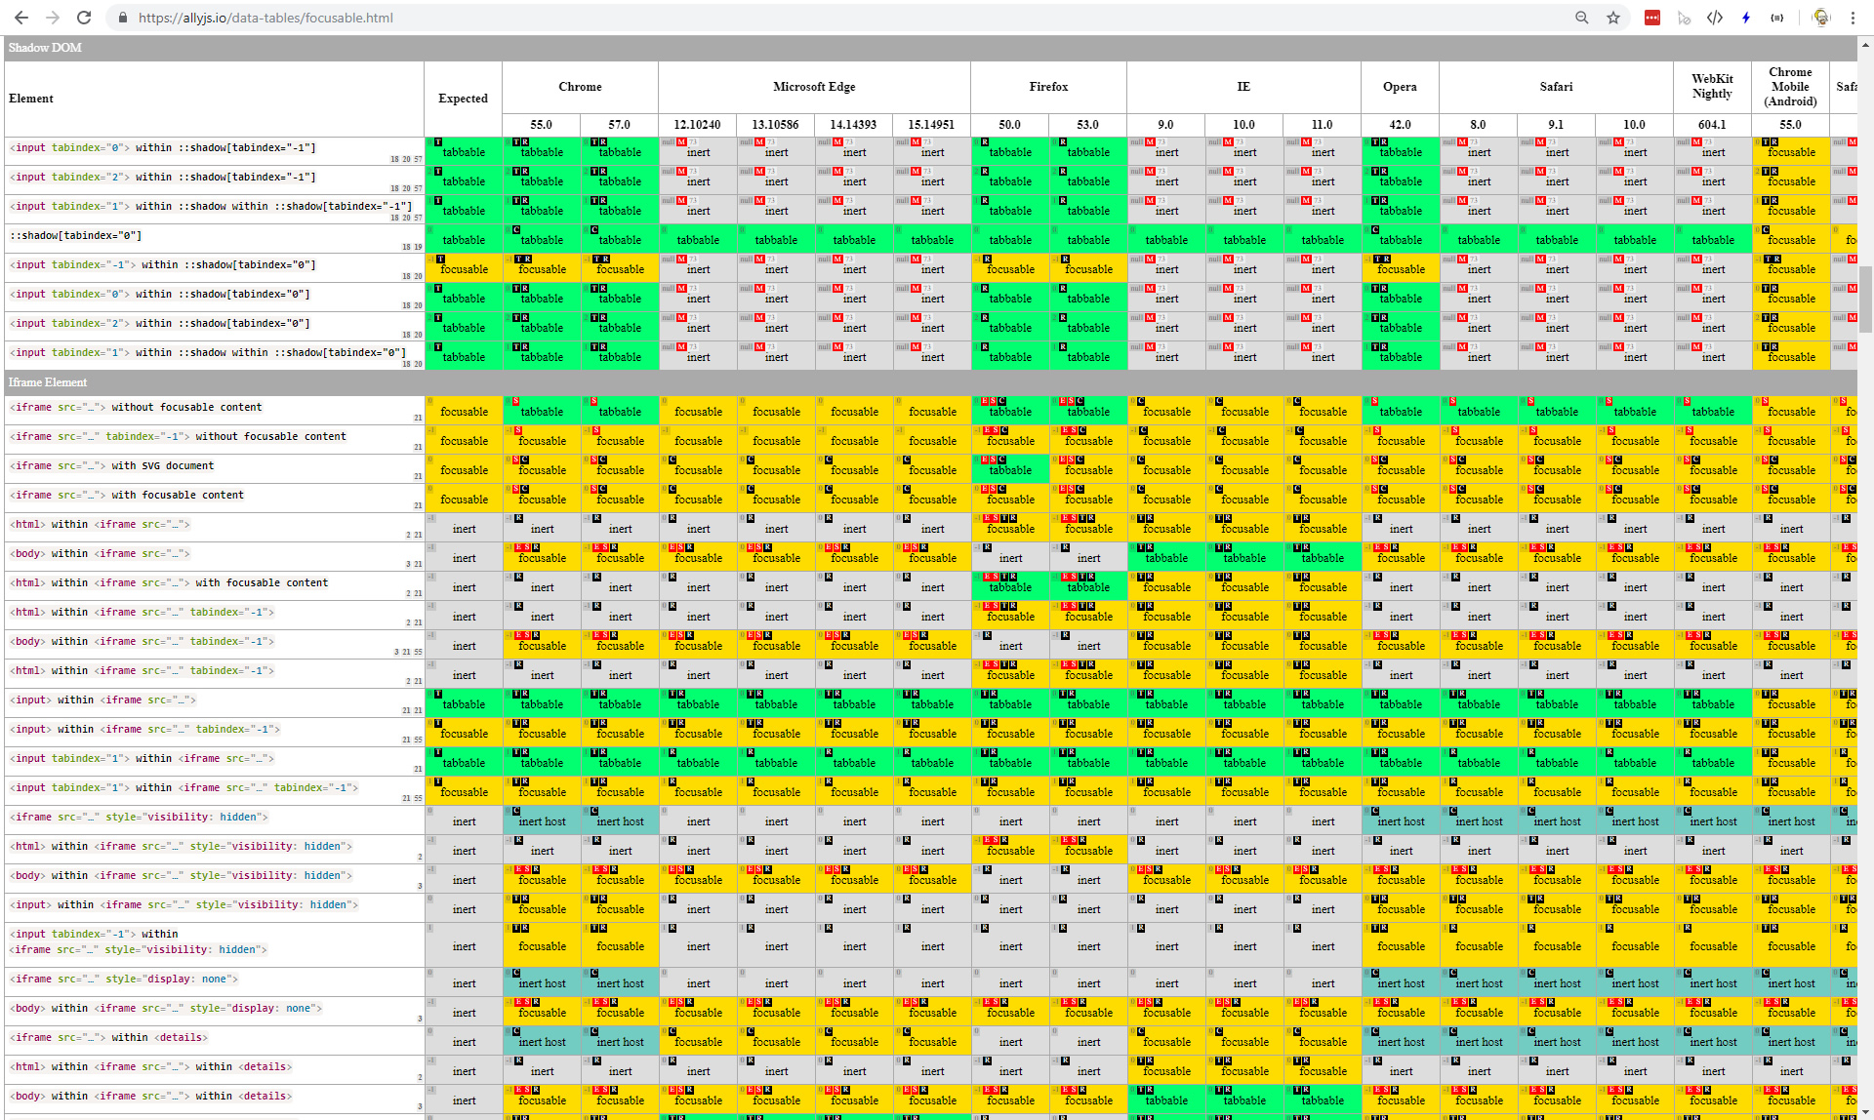
Notes:
To compare
All the ways an element
Can be focusable
And all the edge cases
And all the browser differences…
which I tried to shrink down
and get onto one slide
But it was just too big.
Of course,
we can always go to the Spec
and that should be
super easy to understand.

Slide 66
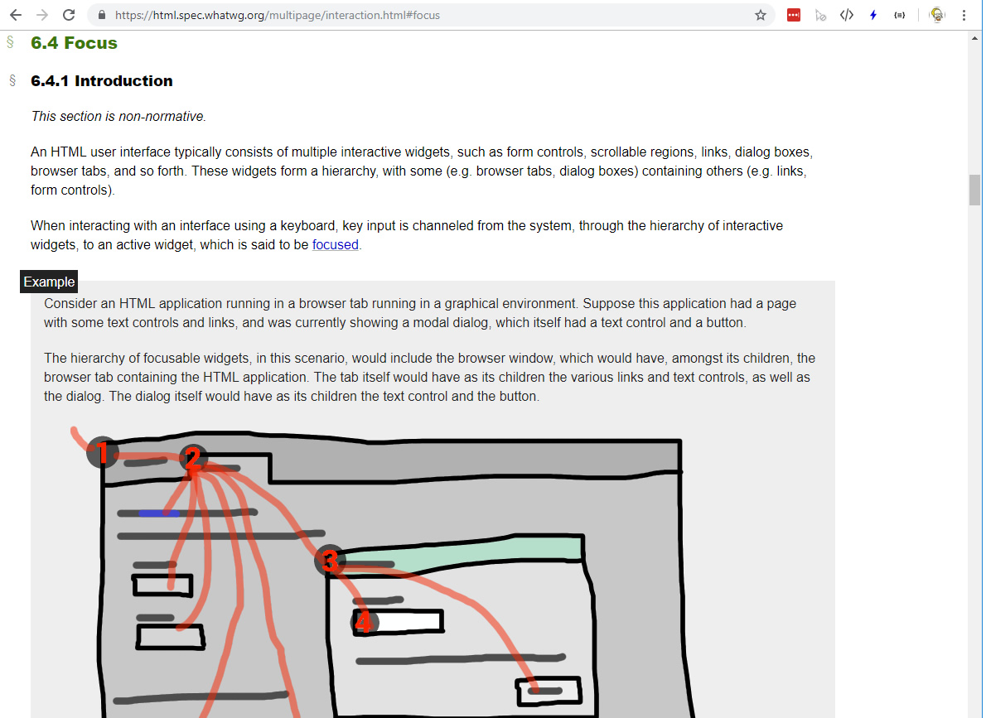
Notes:
Section 6.4 of the HTML Specification
details the focus subsystem.
Here's what it says
about how to determine
if an element
is focusable

Slide 67
Elements that have their tabindex focus flag set, that are not actually disabled, that are not expressly inert, and that are either being rendered or being used as relevant canvas fallback content.
The shapes of area elements in an image map associated with an img element that is being rendered and is not expressly inert.
The user-agent provided subwidgets of elements that are being rendered and are not actually disabled or expressly inert
The scrollable regions of elements that are being rendered and are not expressly inert.
The viewport of a Document that is in a browsing context and is not inert.
Any other element or part of an element, especially to aid with accessibility or to better match platform conventions.
Notes:
And I was going
to read this aloud,
verbatim,
but honestly,
just look at it...
It is complicated
and It is confusing

Slide 68
Elements that have their tabindex focus flag set, that are not actually disabled, that are not expressly inert, and that are either being rendered or being used as relevant canvas fallback content.
The shapes of area elements in an image map associated with an img element that is being rendered and is not expressly inert.
The user-agent provided subwidgets of elements that are being rendered and are not actually disabled or expressly inert
The scrollable regions of elements that are being rendered and are not expressly inert.
The viewport of a Document that is in a browsing context and is not inert.
Any other element or part of an element, especially to aid with accessibility or to better match platform conventions.
Notes:
And even if you
Read the whole thing
You get down to
This last line right here

Slide 69
Elements that have their tabindex focus flag set, that are not actually disabled, that are not expressly inert, and that are either being rendered or being used as relevant canvas fallback content.
The shapes of area elements in an image map associated with an img element that is being rendered and is not expressly inert.
The user-agent provided subwidgets of elements that are being rendered and are not actually disabled or expressly inert
The scrollable regions of elements that are being rendered and are not expressly inert.
The viewport of a Document that is in a browsing context and is not inert.
Any other element or part of an element, especially to aid with accessibility or to better match platform conventions.
Notes:
Which basically says
Browsers can make
Anything they want
Be focusable
At any time.
So trying
To determine
What is focusable
Is not something
We really should
Be in the business
Of doing.

Slide 70
Elements that have their tabindex focus flag set, that are not actually disabled, that are not expressly inert, and that are either being rendered or being used as relevant canvas fallback content.
The shapes of area elements in an image map associated with an img element that is being rendered and is not expressly inert.
The user-agent provided subwidgets of elements that are being rendered and are not actually disabled or expressly inert
The scrollable regions of elements that are being rendered and are not expressly inert.
The viewport of a Document that is in a browsing context and is not inert.
Any other element or part of an element, especially to aid with accessibility or to better match platform conventions.
Notes:
Far smarter people
Than I have tried
And they get it wrong
Every time.
<pause>

Slide 71
Notes:
So we essentially have two problems

Slide 72
1
No way to automatically advance (or reverse) focus
Notes:
we have no easy way
to advance the focus
programmatically.
Or decrement the focus
Programmatically.

Slide 73
1
No way to automatically advance (or reverse) focus
2
No way to determine
what is focusable
Notes:
and we have no easy way
to determine what can receive focus,
what is focusable,
if we wanted to walk the tree.

Slide 74
1
No way to automatically advance (or reverse) focus
2
No way to determine
what is focusable
Notes:
And the annoying thing about
these two problems
is that internally
in the browsers,
both these problems
are already solved.
It's just not exposed.

Slide 75
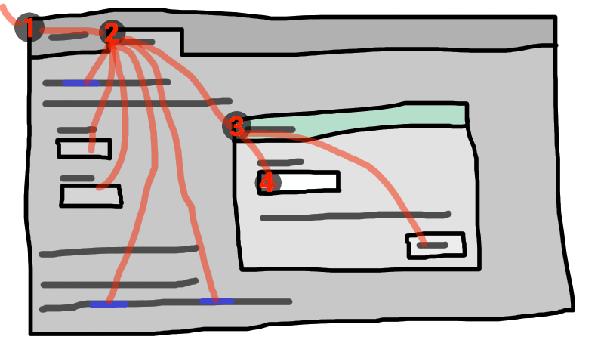
Notes:
The focus subsystem today,
is a mostly passive thing.
we can read it,
we can tell where the focus is
and when it changes,
and we can direct it
if we know exactly
where to direct it.
And this is okay...
but ITS NOT ENOUGH.

Slide 76
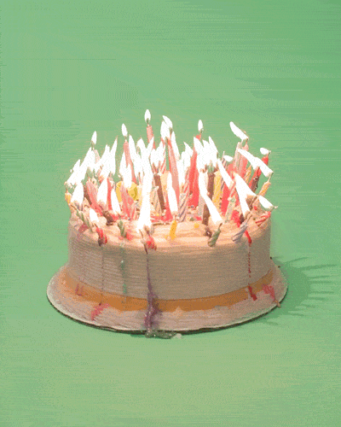
Notes:
It's a twenty year old API
and it is really
starting to show its age.
My Web Component example
Is only one small slice,

Slide 77
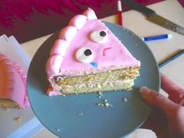
Notes:
One small example,
Of the problems
We are facing
With focus.
Twenty years ago
We hadn’t even begun
To envision
All the things
We would want
Or need
To do with the web.

Slide 78
Notes:
And as we continue
To move the needle
Of what can be done
In a browser,
Focus will continue
to become
More and more
Of a pain point
For developers.
But we can solve
These problems.
We can make
focus better.

Slide 79
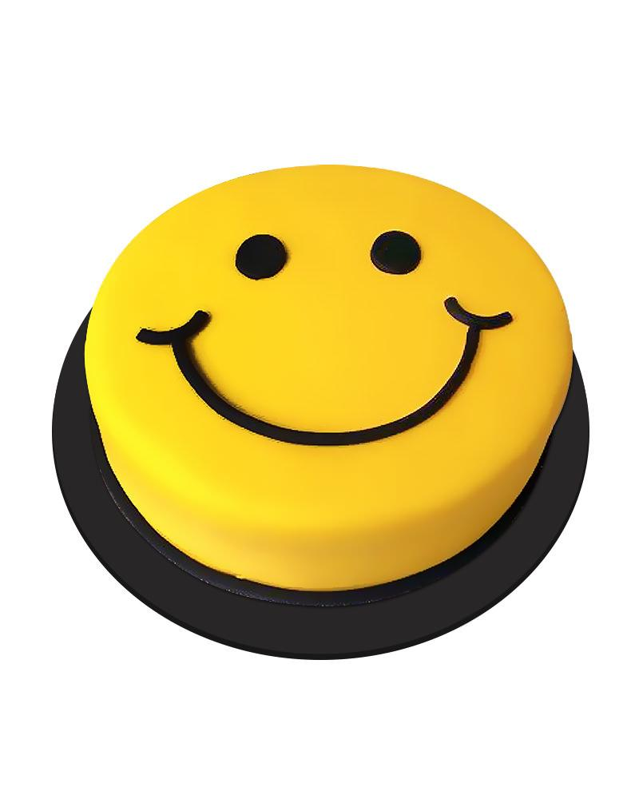
Notes:
We can make it
more powerful
And easier to work with.
We can make focus
help us
Do what we need to do.
And all of that
begins
with exposing
three simple functions...

Slide 80
.isFocusable(e)
Notes:
First,
expose the method
to determine if something
can receive the focus.

Slide 81
.isFocusable(e)
.forward()
.backward()
Notes:
Second and Third,
expose the methods
to move the focus
forward or backward
regardless of where
the focus currently is.

Slide 82
.isFocusable(e)
.forward()
.backward()
Notes:
And consider
what other focus things
We could expose
or add
to make focus better?

Slide 83
.isFocusable(e)
.forward()
.backward()
.trap()
Notes:
What about a function
to trap or limit
focus to a particular container?
meaning focus would cycle
through the focusable elements
in that container,
but never out of it
until told otherwise.

Slide 84
.isFocusable(e)
.forward()
.backward()
.trap()
.order()
Notes:
What about a programmatic way
to order the focusable
elements and enforce
that order.
Sure we have tabindex
to do that
but wouldn't a function
that takes an array of the elements
and does the ordering for us
programmatically
be really helpful?

Slide 85
.isFocusable(e)
.forward()
.backward()
.trap()
.order()
Notes:
And there are other
things that could really make
focus more understandable.
Lots more.

Slide 86
.isFocusable(e)
.forward()
.backward()
.trap()
.order()
.previousActiveElement
.history
Notes:
a previousActiveElement property
or history array
To track
what was previously focused
could be really nice.

Slide 87
.isFocusable(e)
.forward()
.backward()
.trap()
.order()
.previousActiveElement
.history
.autofocus(e)
Notes:
A programmatic way
to set an element
as the first element
to get the focus
once the page is loaded
might also be nice.

Slide 88
.isFocusable(e)
.forward()
.backward()
.trap()
.order()
.previousActiveElement
.history
.autofocus(e)
???
Notes:
And probably other things
We haven't even considered.

Slide 89
.isFocusable(e)
.forward()
.backward()
.trap()
.order()
.previousActiveElement
.history
.autofocus(e)
???
Notes:
All of these
functions and properties
can make focus
so much more useful,
so much more better.
We just need
The courage
To make the changes.
<long pause>
<water>

Slide 90
Notes:
So,
Like any good developer,
With a new idea,
I set out
To address
The shortcomings of focus
By writing
a new library…

Slide 91

Glen’s Awesome JS
Focus Library
Notes:
Obviously
I didnt want to try
and write my own
isFocusable() method,
So naturally,
I did what we all do
On the internet…
<quick pause>
I "stole" one..

Slide 92
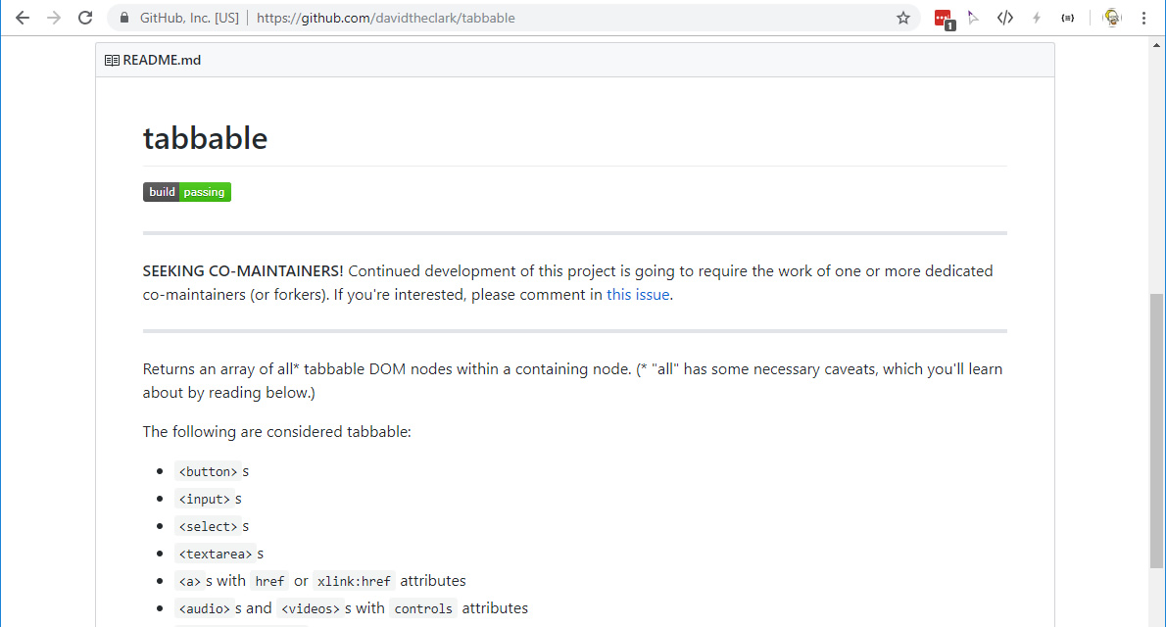
Notes:
The "Tabbable" library
written by David Clark
has a passable
isFocusable()
definition,
So I used that
To get started.
From there I added a global object

Slide 93
window.focusManager
Notes:
called focusManager
for housing
my new focus functions.
<pause>
But as I was writing my code
I started wondering
Why I was
Even doing
This in the first place.
Why Isn't this something
the browsers
just natively have?

Slide 94
Notes:
isn't this something
everyone would want?
Isn't a better focus system
something everyone deserves?
Surely
There must be a way
To help everyone…
<pause>
So let me tell you
About how I
Tried to change
the HTML Specification.

Slide 95

Notes:
First, as most of you may be aware
there are two separate
governing bodies
maintaining the HTML standard
at the same time.
The W3C

Slide 96

Notes:
And the WHATWG

Slide 97
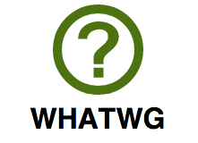
Notes:
And each of them
Work on the specification
Independently
Of one another…

Slide 98
Notes:
At the same time…
One might think
That’s not such
A great idea.
And it really wasn’t.
So…

Slide 99
Notes:
In May of 2019
both the W3C and WHATWG
sign an agreement
to work together
And
that the HTML Specification
work would be done
entirely in the WHATWG.

Slide 100
Notes:
we finally have a single body
overseeing the HTML standard.
And everyone
Is super happy!
Hooray!
<CHEERS>
<quick pause>
Now,
let us say that you are
an incredibly dashing,

Slide 101
Still not Glen…
But let's pretend
Glen is this cool
and popular and super well-known…
Notes:
but not super POPULAR,
Or very WELL KNOWN,
web developer
and you want to propose
some changes
to the HTML specification.
How do you do that?
To start
you would probably google
something like

Slide 102
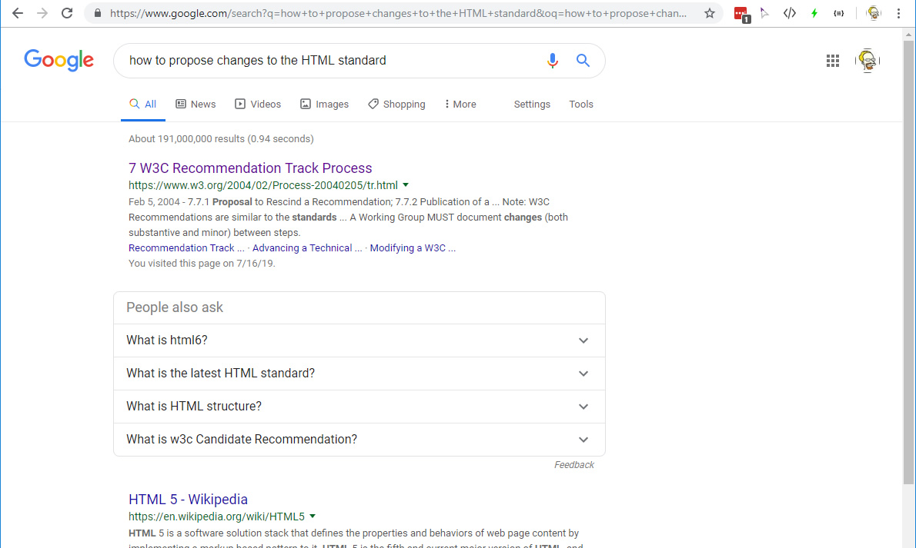
Notes:
"how to propose changes to the HTML standard“
And the first hit you get might be to
the W3C Process Document.
Ooh a process document
That sounds like fun!
It wasn’t.

Slide 103

Notes:
Seriously, it is
An awful thing
To have to read.
But if you were persistent
you might eventually find
something called the
Web Platform Incubator Community Group

Slide 104

Web Platform
Incubator
Community
Group
Notes:
or WICG
which was formed in 2015
to allow people
like you and I
to make proposals.
Sounds like exactly what
you are looking for,
Right?
So you write up your idea
and submit it to the WICG
discourse group
for discussion…

Slide 105
Web Platform
Incubator
Community
Group
Notes:
But things go slowly.
And few people
If any
seem to care.
And then
the aforementioned agreement
between the W3C and WHATWG
comes down.

Slide 106
Notes:
and suddenly you realize
you need to get your proposal
in front of WHATWG eyeballs
Not the WICG eyeballs.

Slide 107
Notes:
But what you don’t realize
Is that both of these processes
Have a fundamental flaw.
See,
The process for
submitting a proposal
Is pretty easy,
But the process for getting
Anyone to look at it
Or consider it
Is incredibly hard.

Slide 108
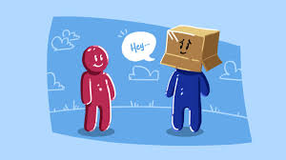
Notes:
In order for your proposal
To get any kind of response
You are first required
SELL IT.
And not everyone
Is good at selling.
I am not good at selling.

Slide 109
Notes:
The WHATWG process
Specifically requires you to
Find and convince
Browser manufacturers,
The people who write chrome,
Or firefox,
Or edge,
Or Safari,
You have to convince them
That your idea is worthy.

Slide 110
Notes:
And that’s really hard
Especially
If you are an incredibly dashing

Slide 111
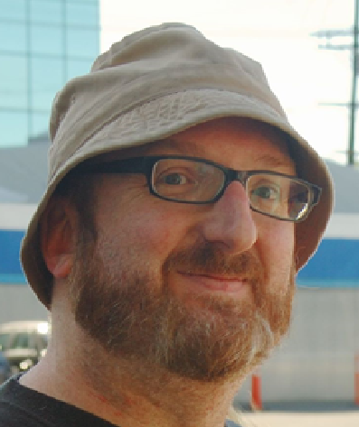

Notes:
but not very popular
Or well known,
Web developer named Glen
So you do the next best thing.

Slide 112





Notes:
You make a tweet.
You write a few articles.
You post to reddit and hackernews.
You promote, promote, promote.
You literally do everything
You can think of…
But eyeballs
Are hard to find…
So You decide
to take your idea on the road;

Slide 113

Notes:
And tell
The best developers
In the whole world
About your idea!
HI EVERYONE!
You take a room full
Of great minds
And you
Tell them all about
The Focus Traversal API Proposal

Slide 114
The
Focus Traversal API
Proposal
Notes:
This is my proposal
To make focus better…
A Formal Proposal
to the HTML Specification
This proposal
formally introduces the concepts
of a Focus Traversal API system
to solve the problems
we discussed earlier
And to make focus
Easier to programmatically use.

Slide 115
The Focus Traversal API Proposal
focusManager.isFocusable(e)
focusManager.forward()
focusManager.backward()
focusManager.next(e)
focusManager.previous(e)
focusManager.hasFocus(e)
focusManager.focus(e)
focusManager.orderedElements()
focusManager.currentlyFocused
focusManager.previouslyFocused
focusManager.history
Coming Soon…
focusManager.trap(e)
focusManager.order(a)
focusManager.autofocus(e)
Notes:
In the proposal
I suggest
a set of additions
to move the focus system
Forward.

Slide 116
The Focus Traversal API Proposal
focusManager.isFocusable(e)
focusManager.forward()
focusManager.backward()
focusManager.next(e)
focusManager.previous(e)
focusManager.hasFocus(e)
focusManager.focus(e)
focusManager.orderedElements()
focusManager.currentlyFocused
focusManager.previouslyFocused
focusManager.history
Coming Soon…
focusManager.trap(e)
focusManager.order(a)
focusManager.autofocus(e)
Notes:
This includes creating
a top level `window` property
called `focusManager`
to expose
a series of properties and methods
for working with Focus traversal.

Slide 117
The Focus Traversal API Proposal
focusManager.isFocusable(e)
focusManager.forward()
focusManager.backward()
focusManager.next(e)
focusManager.previous(e)
focusManager.hasFocus(e)
focusManager.focus(e)
focusManager.orderedElements()
focusManager.currentlyFocused
focusManager.previouslyFocused
focusManager.history
Coming Soon…
focusManager.trap(e)
focusManager.order(a)
focusManager.autofocus(e)
Notes:
It contains,
as previously described,
Functions for determining
what is focusable,
functions
for incrementing
and decrementing focus
and
for a host of other
focus related tasks
To make everyone’s
Lives easier.

Slide 118
The Focus Traversal API Proposal
focusManager.isFocusable(e)
focusManager.forward()
focusManager.backward()
focusManager.next(e)
focusManager.previous(e)
focusManager.hasFocus(e)
focusManager.focus(e)
focusManager.orderedElements()
focusManager.currentlyFocused
focusManager.previouslyFocused
focusManager.history
Coming Soon…
focusManager.trap(e)
focusManager.order(a)
focusManager.autofocus(e)
Notes:
This is the proposal
I have submitted it to the WICG
and the WHATWG
and worked to get
it promoted and discussed
and now I'm telling you
Fine folks
all about it.

Slide 119
The Focus Traversal API Proposal
github.com/awesomeeng/FocusTraversalAPI
npm install focus-traversal-api-polyfill
Notes:
I even fleshed out my
original library
and made a working polyfill
For the proposal
that you can use today
to shim all these
cool and useful
focus functions
into your applications
until we can get actual implementation
in the browsers.

Slide 120
The Focus Traversal API Proposal
github.com/awesomeeng/FocusTraversalAPI
npm install focus-traversal-api-polyfill
Notes:
Unfortunately though,
actual implementation
is a long
long
way away.

Slide 121
The Focus Traversal API Proposal
github.com/awesomeeng/FocusTraversalAPI
npm install focus-traversal-api-polyfill
Notes:
As I said,
The WHATWG process
for enacting change
requires you to
convince browser manufacturers
on your own
that your idea is worthy
of their time.
And I can count
on zero hands
the number of browser manufacturers
I know how to talk to.
But there is hope!
<look over crowd>

Slide 122
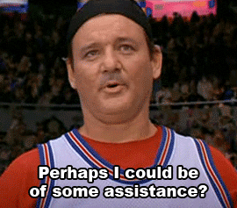
Notes:
You.
You can help.
I need people to
comment on the proposal
on the WICG or WHATWG
and get involved in
the process.

Slide 123
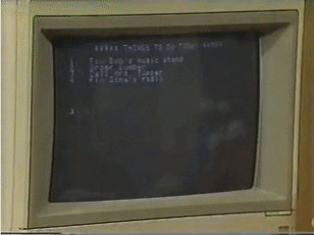
Notes:
I need people to
download the polyfill,
try it out,
find the bugs,
help grow the code.

Slide 124

Notes:
I need people to help
come up with ideas,
write tests,
be involved!

Slide 125

Notes:
And I
especially
need people
To help
spread the word.
So,
To that end…
I'm going to
live tweet a picture
from this very talk.
And…

Slide 126
Let’s make Browser Focus work for us… Spread the word about the Focus Traversal API Proposal!
https://github.com/awesomeeng/FocusTraversalAPI
#FocusTraversalAPI #JavaScript #Web
@AREINET
Notes:
with this text
and links
and I need
ALL OF YOU
to go retweet it
and help
spread the word
with us.
<live tweet>

Slide 127
Let’s make Browser Focus work for us… Spread the word about the Focus Traversal API Proposal!
https://github.com/awesomeeng/FocusTraversalAPI
#FocusTraversalAPI #JavaScript #Web
@AREINET
Notes:
Alright,
it's posted.
Go retweet it
And help
Spread the word.
Together,
And only together,
We can make focus
Better,
More powerful,
And easier for everyone.

Slide 128
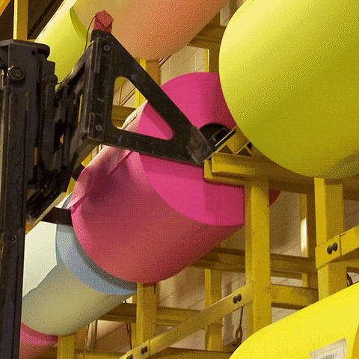
Notes:
Finally,
if you are a browser manufacturer,
or have any sway with them,
Or know anyone
I could reach out to…
come talk to me.
And lets figure out together
How we can all
advance focus!
<quick pause>

Slide 129
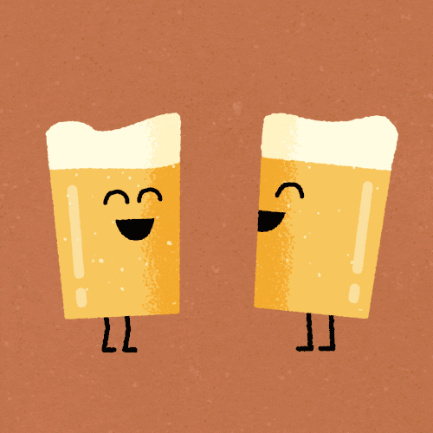
Notes:
Thanks for listening,
And the retweeting.
And I hope to
Talk with
All of you in the coming days,
About focus,
Or life,
Or really good beer.
Thanks for your focus.

Slide 130
Focus Traversal API Explainer
https://github.com/awesomeeng/FocusTraversalAPI/blob/master/EXPLAINER.md
Github Repo
https://github.com/awesomeeng/FocusTraversalAPI
Github Get Involved Page
https://github.com/awesomeeng/FocusTraversalAPI/blob/master/GET_INVOLVED.md
WICG W3C Discourse Discussion
https://discourse.wicg.io/t/proposal-focus-traversal-api/3427
WHATWG Github Issue
https://github.com/whatwg/html/issues/4784
ZephJS Library
https://zephjs.com
Notes:
Thank you.

